Slide 1
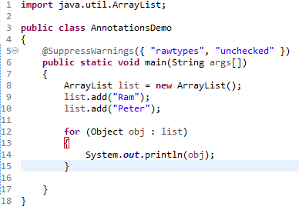
Java Annotations
Java Annotation is a tag that represents the metadata i.e. attached with class, interface, methods or fields to indicate some additional information which can be used by java compiler and JVM.
Annotations in java are used to provide additional information, so it is an alternative option for XML and java marker interfaces.
Built-In Java Annotations
There are several built-in annotations in java. Some annotations are applied to java code and some to other annotations.
Built-In Java Annotations used in java code
@Override
@SuppressWarnings
@Deprecated
Built-In Java Annotations used in other annotations
@Target
@Retention
@Inherited
@Documented
Java annotations are typically used for the following purposes:
Compiler instructions
Build-time instructions
Runtime instructions

